Slide 1
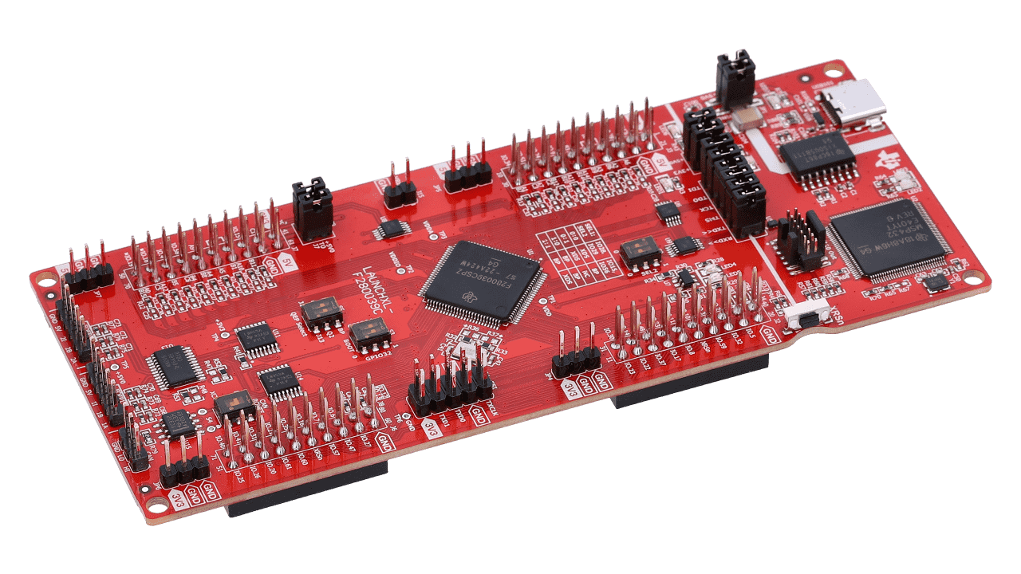

ECEN 404 Final Presentation
Team 1: ADC Resolution vs. Sensorless Motor Control Performance
Cristian Ornelas, Tyler Hawkins, Tamara Basfar, John King Sponsor: Kevin Allen (Texas Instruments) TA: Fahrettin Ay

Slide 2
Problem Overview
Problem: How do different configurations of sensorless motor control affect performance?
Solution: Port the universal motor control software to one of TI’s newest c2000 devices. Develop updated configurations of the universal solution, and test the effects on sensorless control performance.

Slide 3
What We Are Testing
8 Total Configurations
Float 32 operations Vs Float 64 operations
12 bit ADC Vs 16 bit ADC
No Oversampling Vs Oversampling

Slide 4
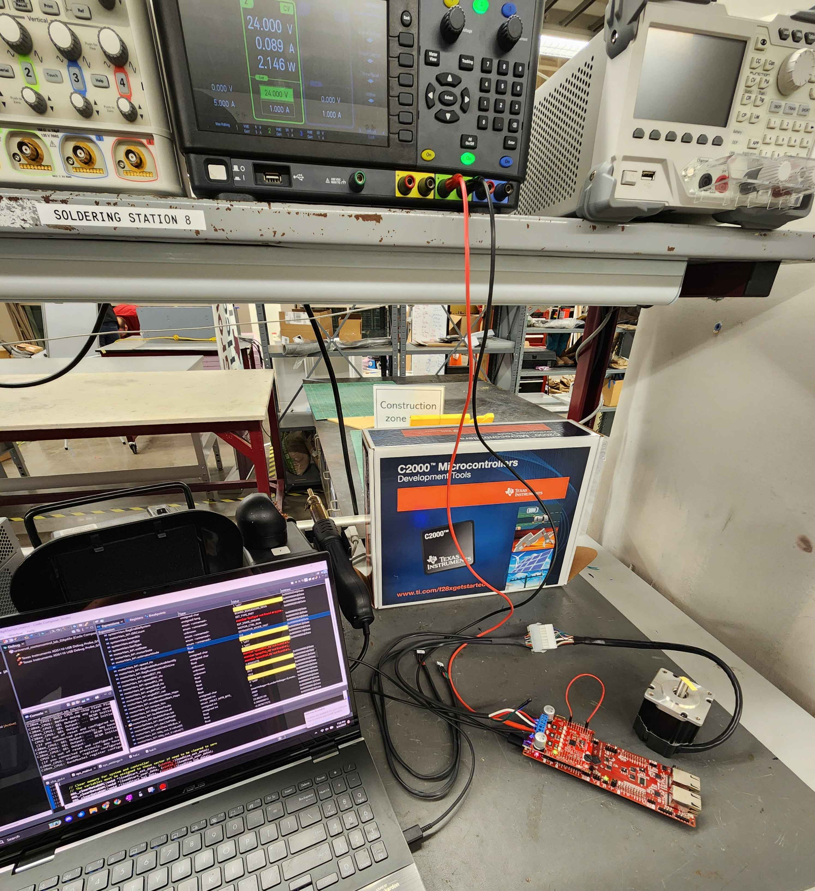
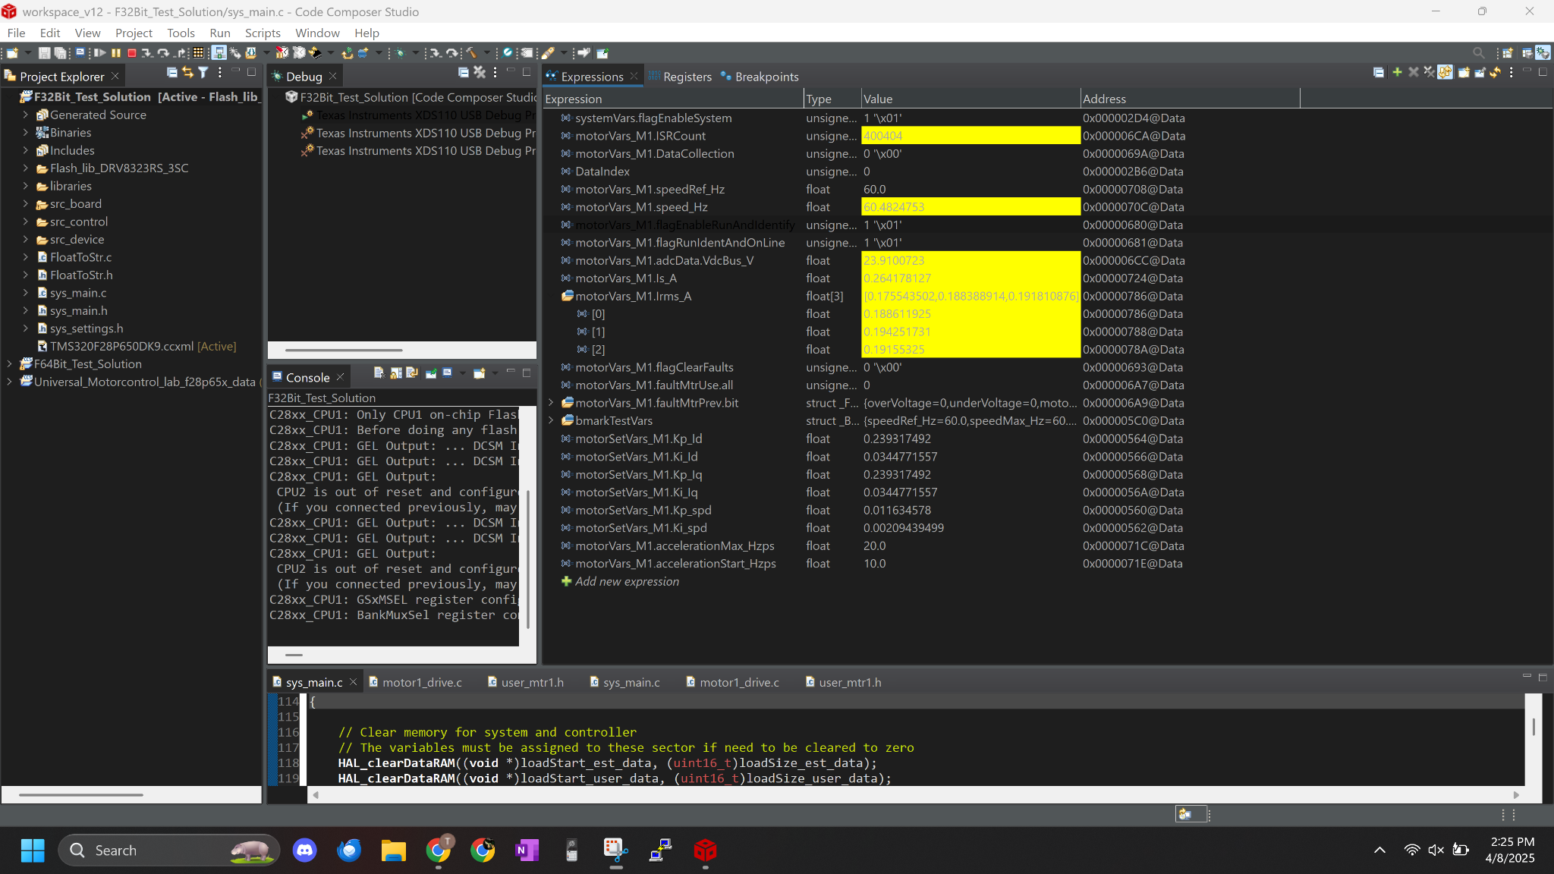
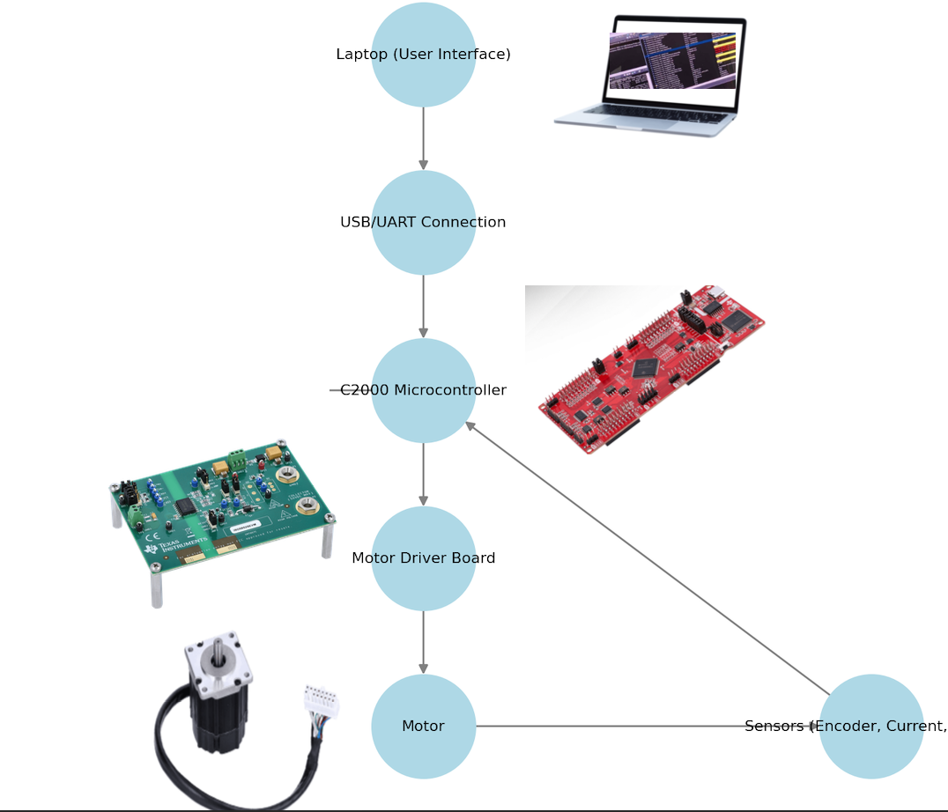
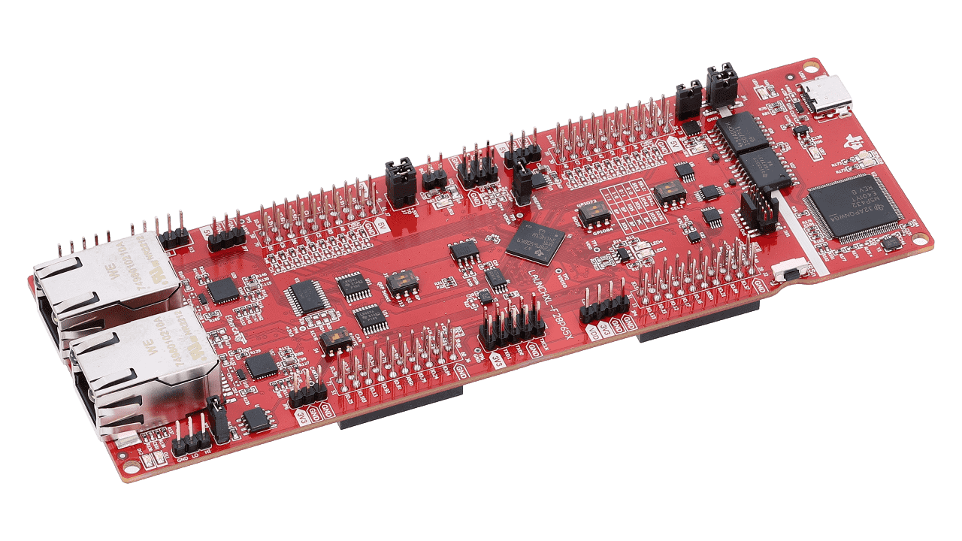
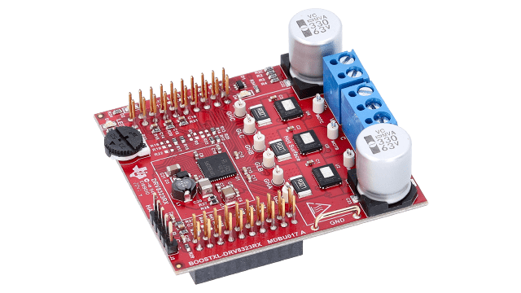
Integrated System Diagram
Notes:
Low voltage servo motor

Slide 5
Solution Porting & Data Collection
-Tyler Hawkins

Slide 6
Engineering Design Accomplishments
Solution Porting & Data Collection
Ported over the full Universal Motor Control solution to the F28P65X Launchpad and DRV8323 Driver board from F28002X
Verified ported solution using TI’s Universal Motor Control specifications
Developed and tested a method of data collection for system testing
Redesigned and 3d printed Brake mount for load testing

Slide 7
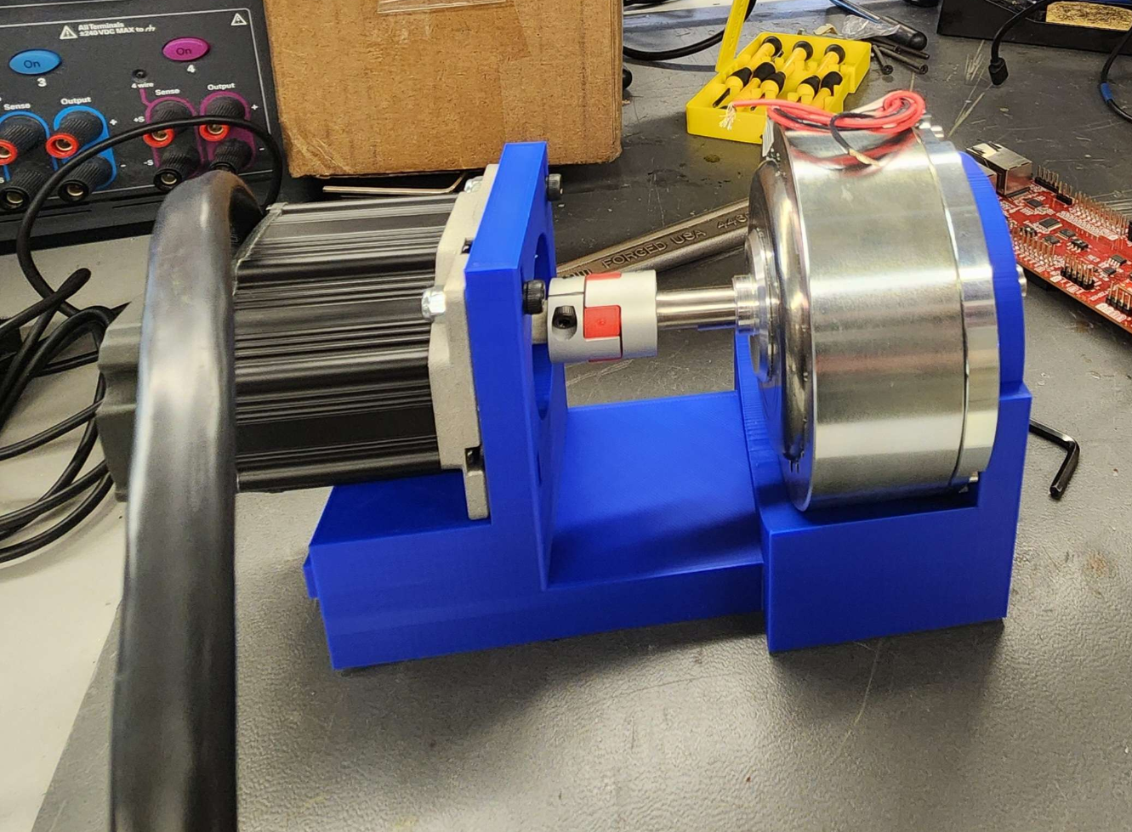
Engineering Design Accomplishments
Solution Porting & Data Collection
Data is sent over UART using Putty
115200 Baud Rate
Collects data point every 1 ms for 30s for a total of 30,000 data points

Slide 8
Estimator & Float 64 Estimator Update
-John King

Slide 9
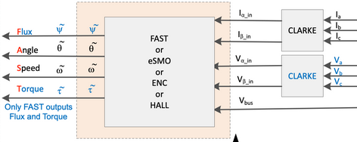
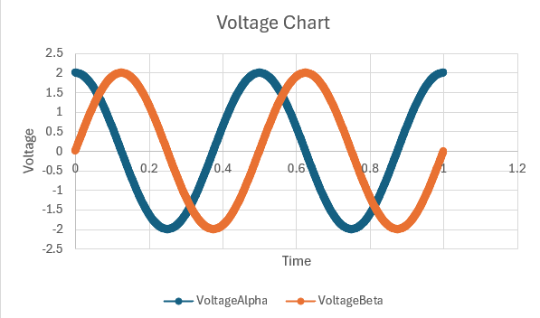
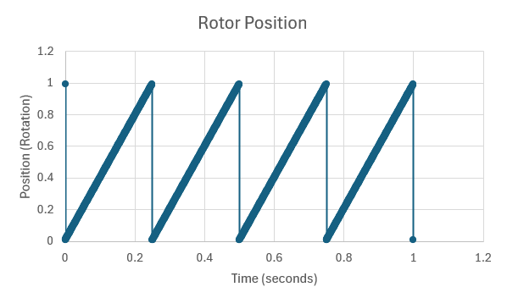
Engineering Design Accomplishments
Estimator subsystem
Developed Estimator control code
Achieved accurate prediction of motor orientation based on back voltage input.

Slide 10
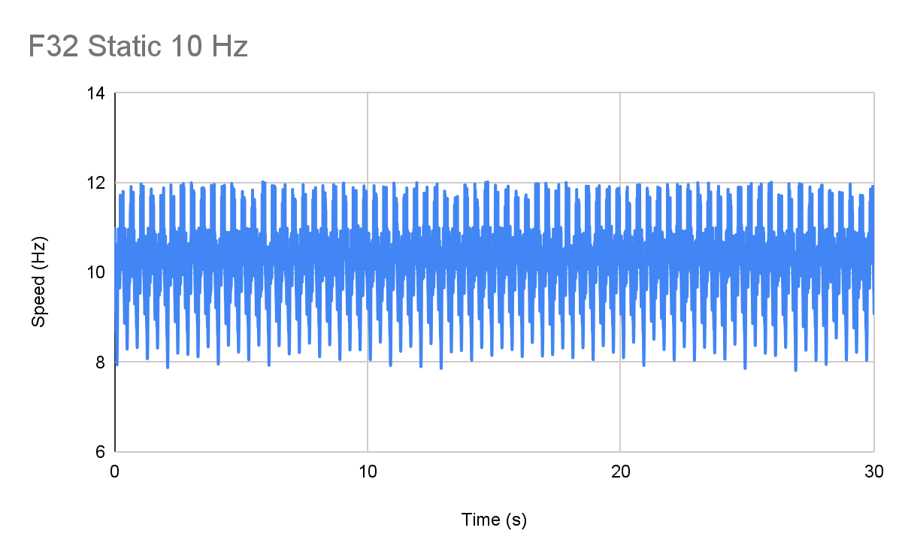
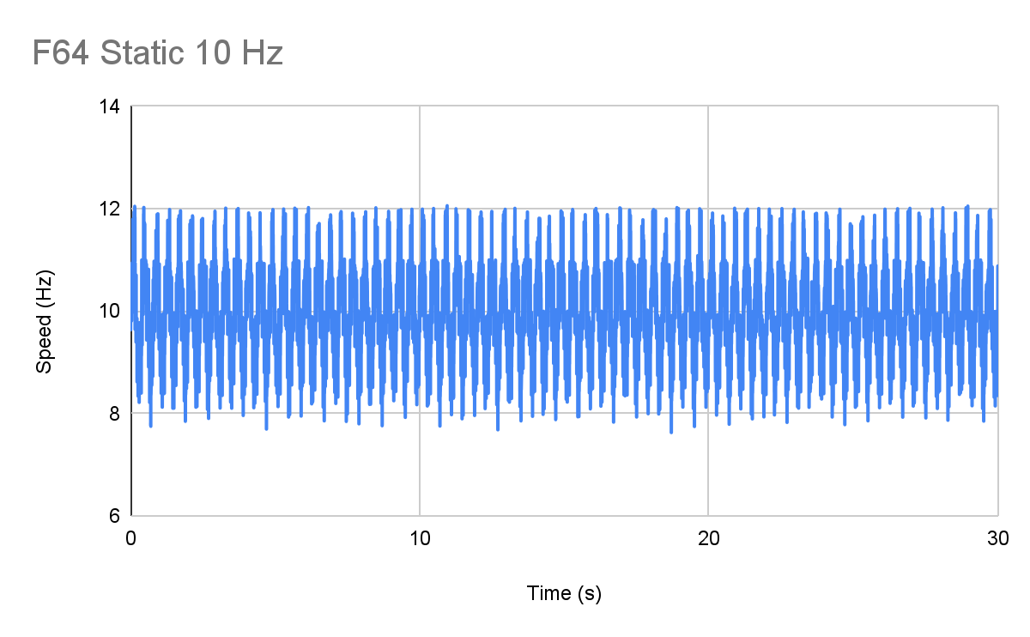
Engineering Design Accomplishments
Float 64 Estimator Update
Modified the estimator code to run float 64 calculations instead of float 32.
Tested and verified that the updated code functioned as intended and utilized correct values.
F32 Max. | F32 Min. | F32 Avg. | σ
11.999 | 7.814 | 10.053 | 0.826
F64 Max. | F64 Min. | F64 Avg. | σ
11.999 | 7.6345 | 10.044 | 0.756

Slide 11
PWM & Oversampling
-Tamara Basfar

Slide 12
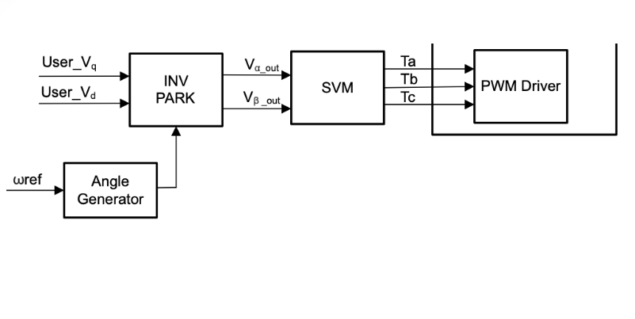
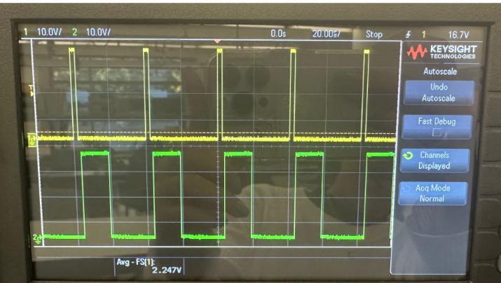
Engineering Design Accomplishments
PWM subsystem
Developed PWM control path
Achieved precise timing, resolution, and safe switching
Validated frequency, duty cycle, and dead-time
Requirement | Spec | Measured Performance
PWM frequency | 20 kHz | 20.02 kHz (±0.1%)
Duty cycle resolution | ≤1% error | Measured 0.6% max error
Dead-time insertion | ≥500ns | Verified at 520ns

Slide 13
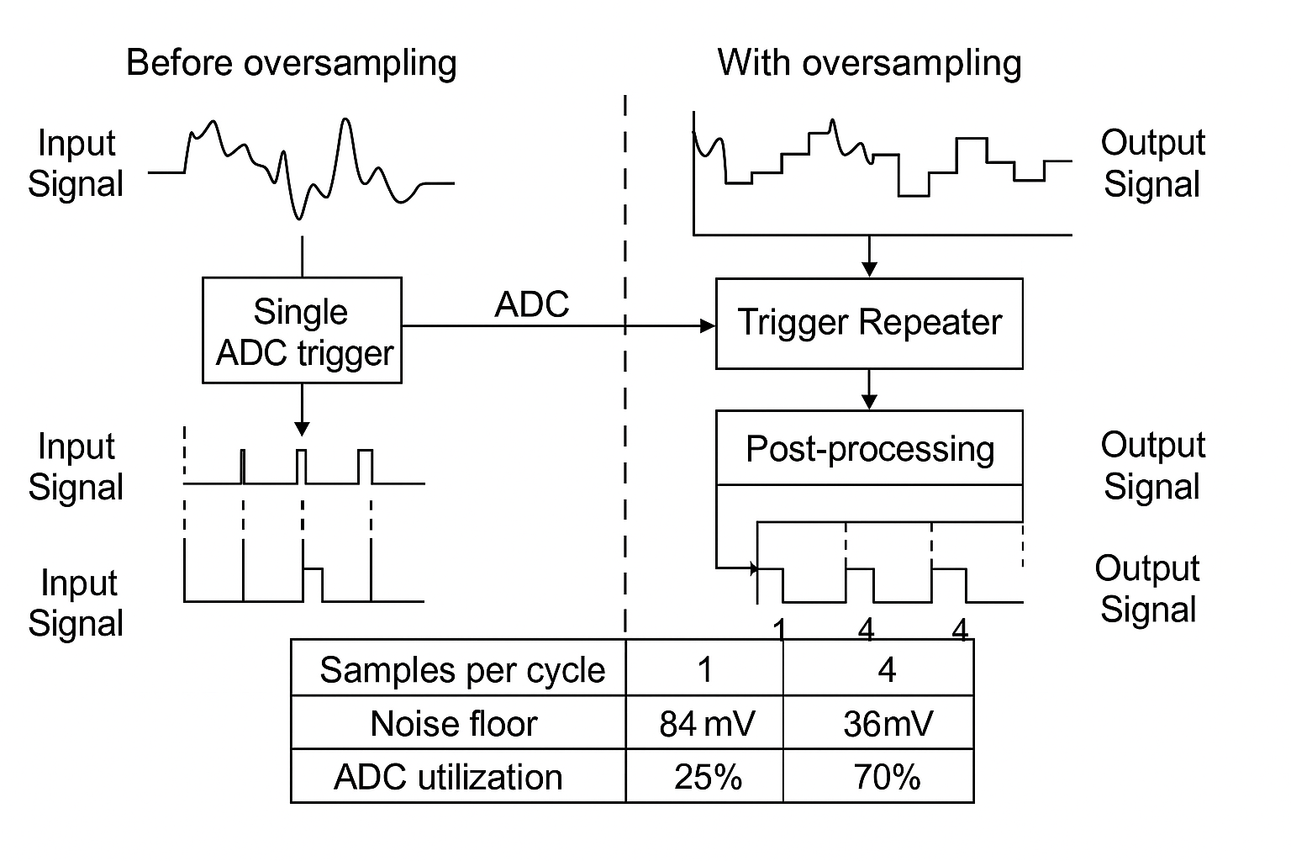
Engineering Design Accomplishments
oversampling update
Implemented ADC oversampling using trigger repeater
In individual example cut current sense noise floor by 57%
Added post-processing to reduce CPU load
ADC utilization increased

Slide 14
ADC & 12 bit vs 16 Resolution
-Cristian Ornelas

Slide 15
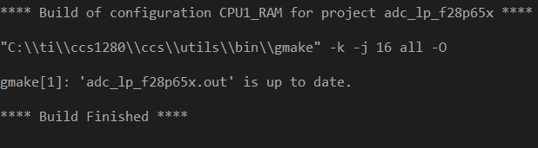
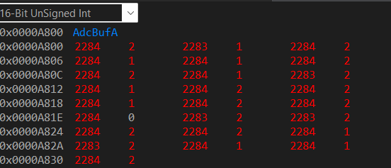
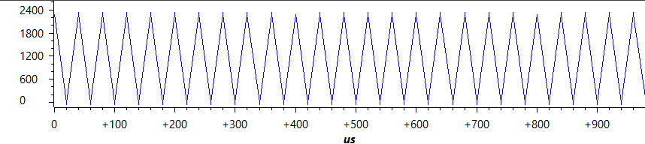
Engineering Design Accomplishments
ADC Subsystem
Developed an ADC Module that properly converts analog to digital signals
Validated the behavior of the ADC module using TI’s code composer waveform and LED lights on the F28P65x board.
Task | Specification | Result
Buffer | The memory result buffer will show the behavior of ADC A | The ADC will toggle the values in the 12-bit memory buffer from 4095 to 0
LED | LED 4 show the behavior of the GPIO pin on the f28p65x board | The LED 4 will blink on and off as ADC A is converting

Slide 16
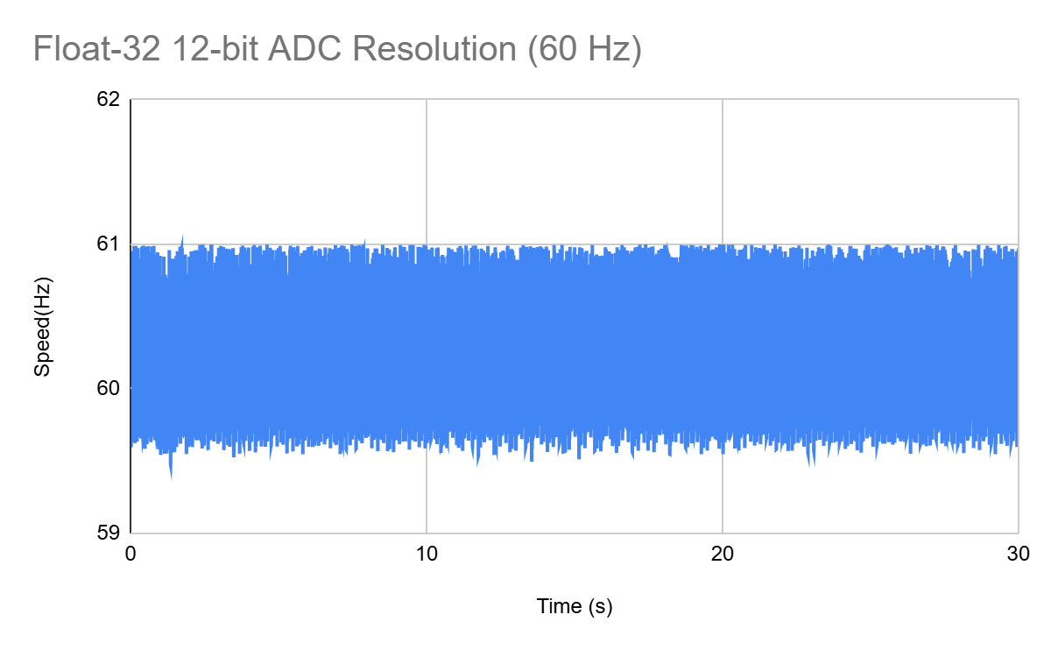
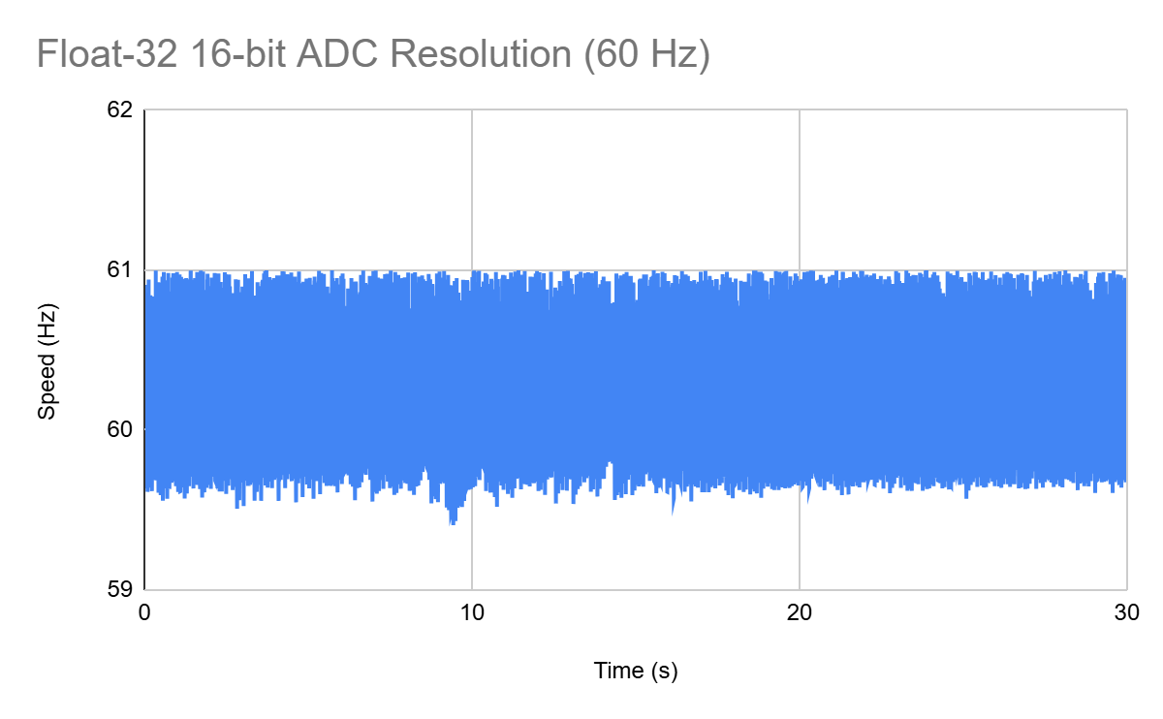
Engineering Design Accomplishments
12/16 ADC Resolution Update
Modified software to run 12-bit and 16-bit ADC resolution interchangeably.
Validated the update to show that the correct current and voltage values were appearing: along with the sensorless motor spinning properly.
Max | 60.999 Hz
Min | 59.475 Hz
Avg | 60.107 Hz
σ | 0.3376
Max | 60.999 Hz
Min | 59.406 Hz
Avg | 60.092 Hz
σ | 0.3192

Slide 17
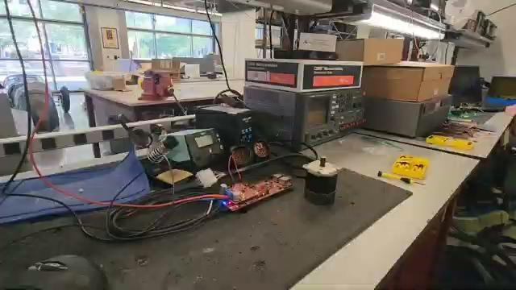

Slide 18
Static Speed Performance
60 Hz
Configuration | Maximum | Minimum | Average | σ
F32 | 60.999 | 59.475 | 60.106 | 0.337
F32+OS | 60.999 | 59.4569 | 60.09 | 0.334
F32+16 | 60.999 | 59.406 | 60.091 | 0.319
F32+OS+16 | 60.999 | 59.4667 | 60.092 | 0.324
F64 | 60.999 | 59.6218 | 60.099 | 0.289
F64+OS | 60.999 | 59.508 | 60.096 | 0.293
F64+16 | 60.999 | 59.1609 | 60.097 | 0.301
F64+OS+16 | 60.999 | 59.1618 | 60.096 | 0.302

Slide 19
Static Speed Performance
300 Hz
Configuration | Maximum | Minimum | Average | σ
F32 | 300.999 | 299.754 | 300.21 | 0.315
F32+OS | 301.815 | 298.579 | 300.147 | 0.365
F32+16 | 300.999 | 297.925 | 300.156 | 0.374
F32+OS+16 | 301.212 | 298.775 | 300.131 | 0.352
F64 | 300.999 | 299.46 | 300.192 | 0.328
F64+OS | 300.999 | 298.685 | 300.162 | 0.323
F64+16 | 300.999 | 299.199 | 300.098 | 0.335
F64+OS+16 | 301.898 | 298.796 | 300.058 | 0.367

Slide 20
Static Speed Performance
10 Hz
Configuration | Maximum | Minimum | Average | σ
F32 | 11.999 | 7.814 | 10.053 | 0.826
F32+OS | 11.998 | 7.425 | 10.043 | 0.991
F32+16 | 11.994 | 8.267 | 10.049 | 0.735
F32+OS+16 | 11.997 | 7.205 | 10.037 | 1.064
F64 | 11.999 | 7.634 | 10.044 | 0.755
F64+OS | 11.998 | 7.693 | 10.05 | 0.751
F64+16 | 11.998 | 7.689 | 10.051 | 0.765
F64+OS+16 | 11.998 | 8.434 | 10.043 | 0.684

Slide 21
Speed Step Performance
Speed was Increased every 6 seconds
60 Hz > 300 Hz in 60 Hz steps

Slide 22
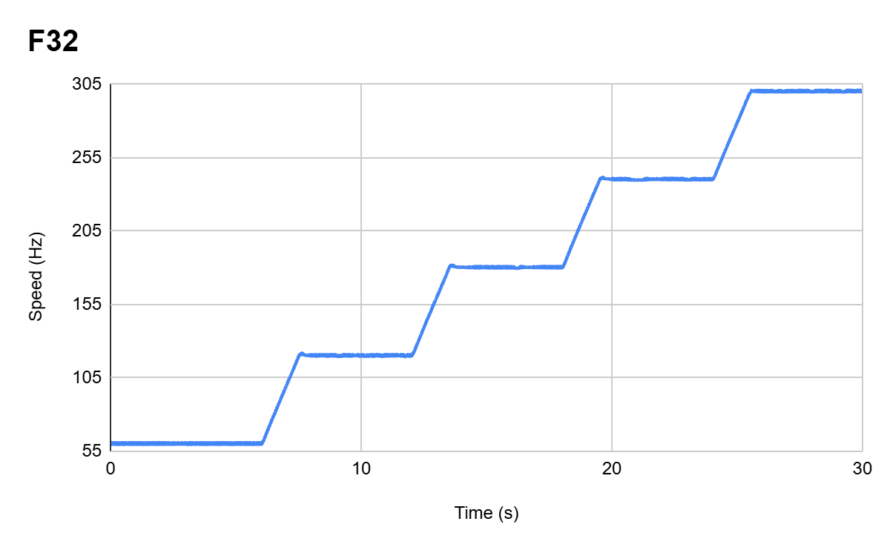

Slide 23
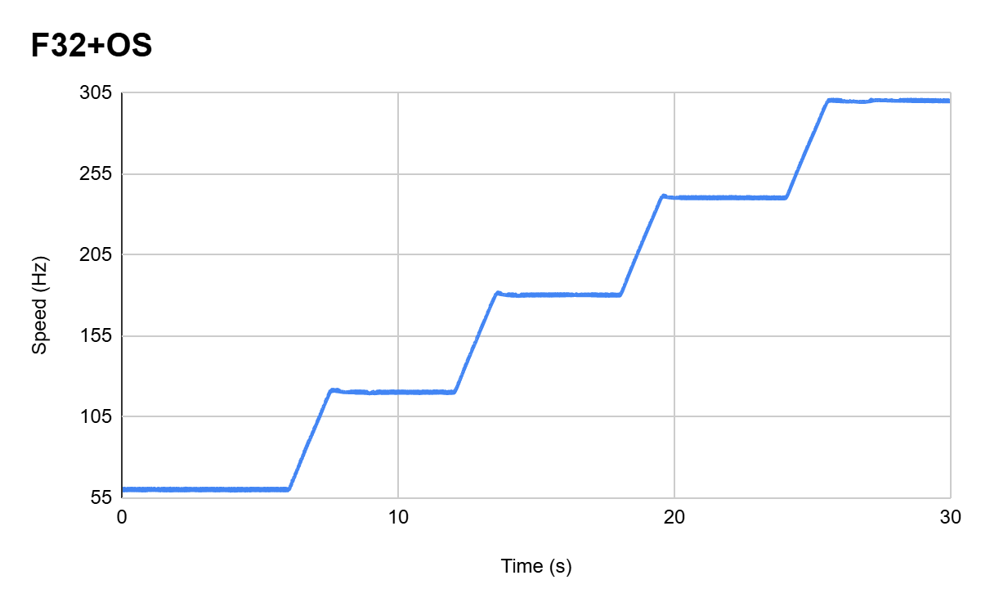

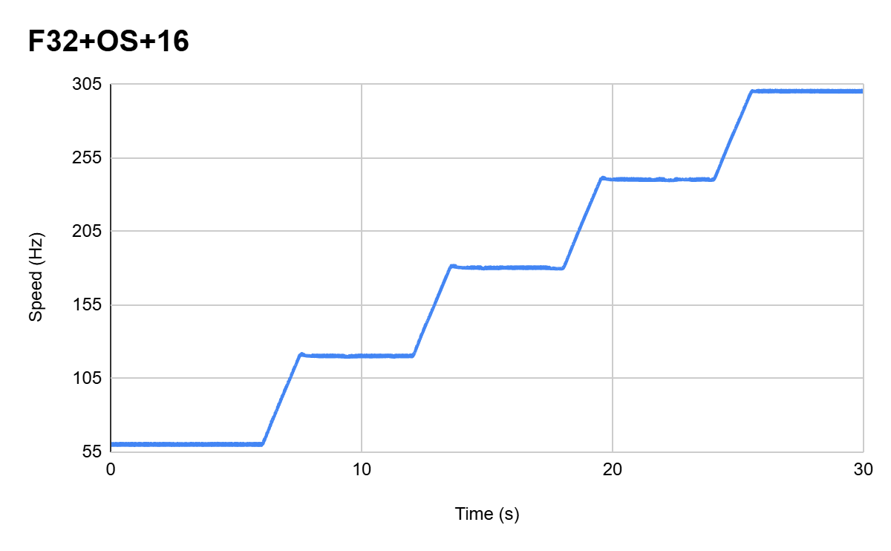

Slide 24
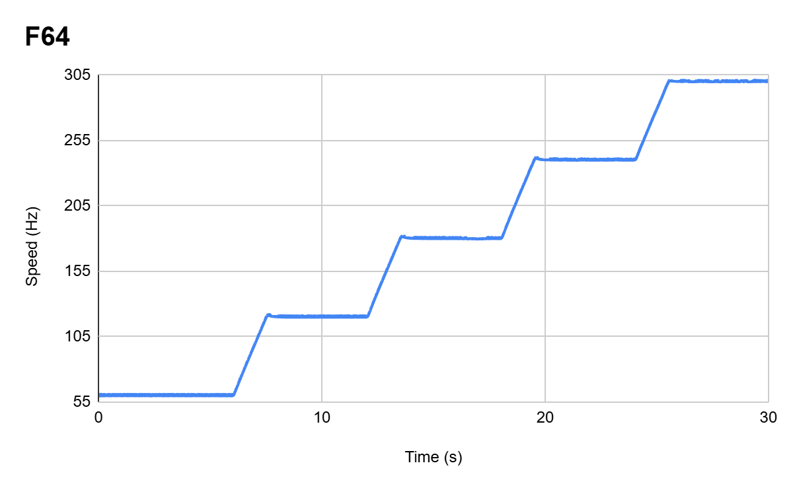
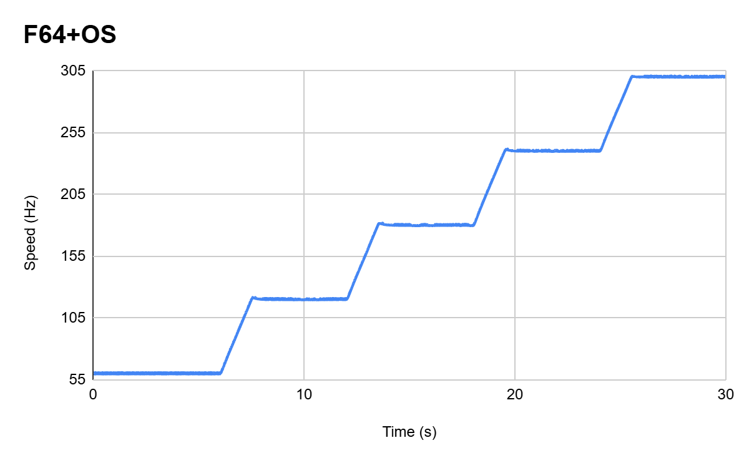
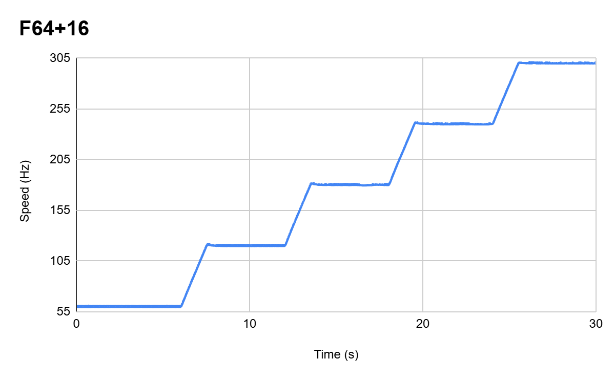
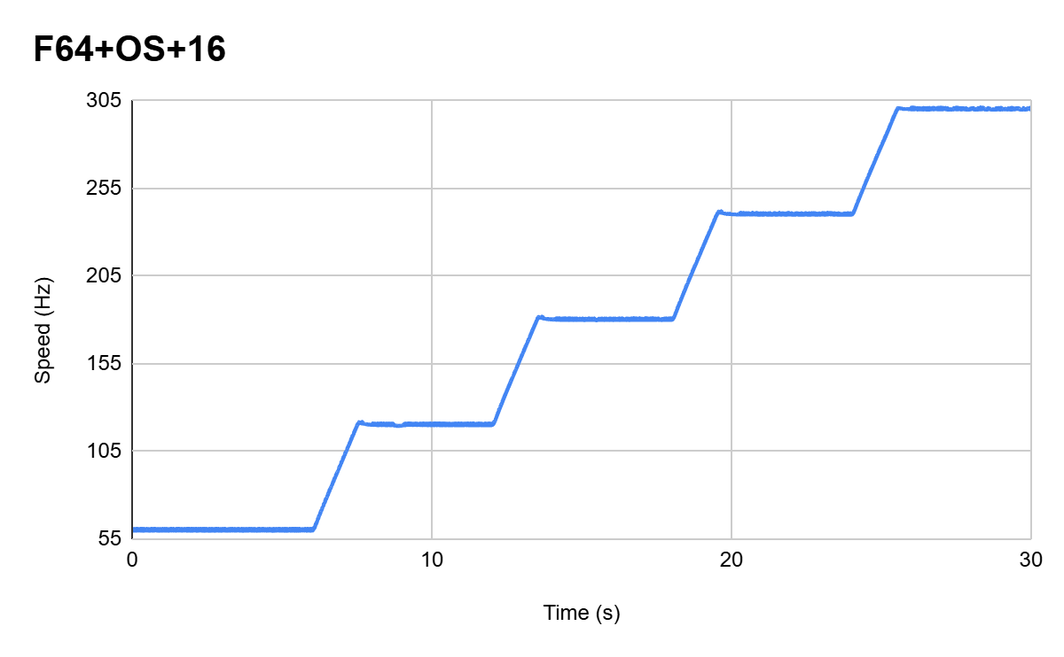

Slide 25
Increasing Load Performance
Load was Increased every 5 seconds with use of a hysteresis brake and variable power supply

Slide 26
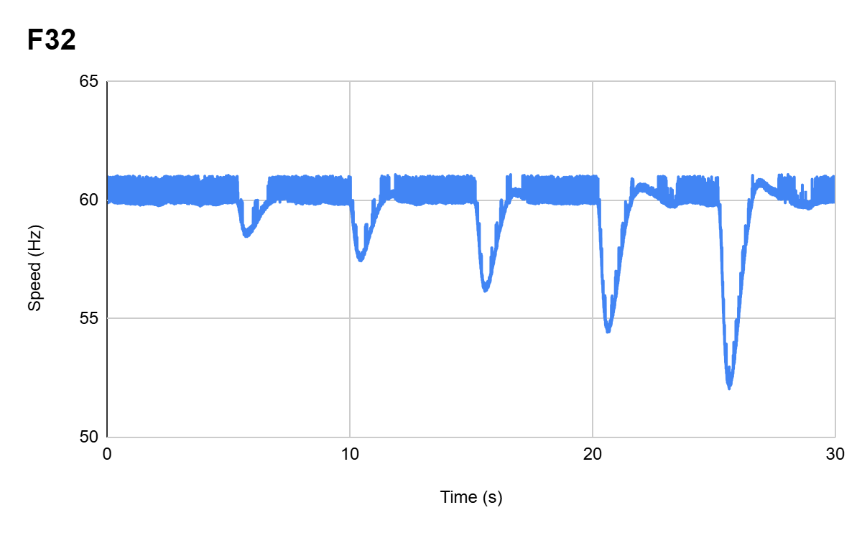

Slide 27
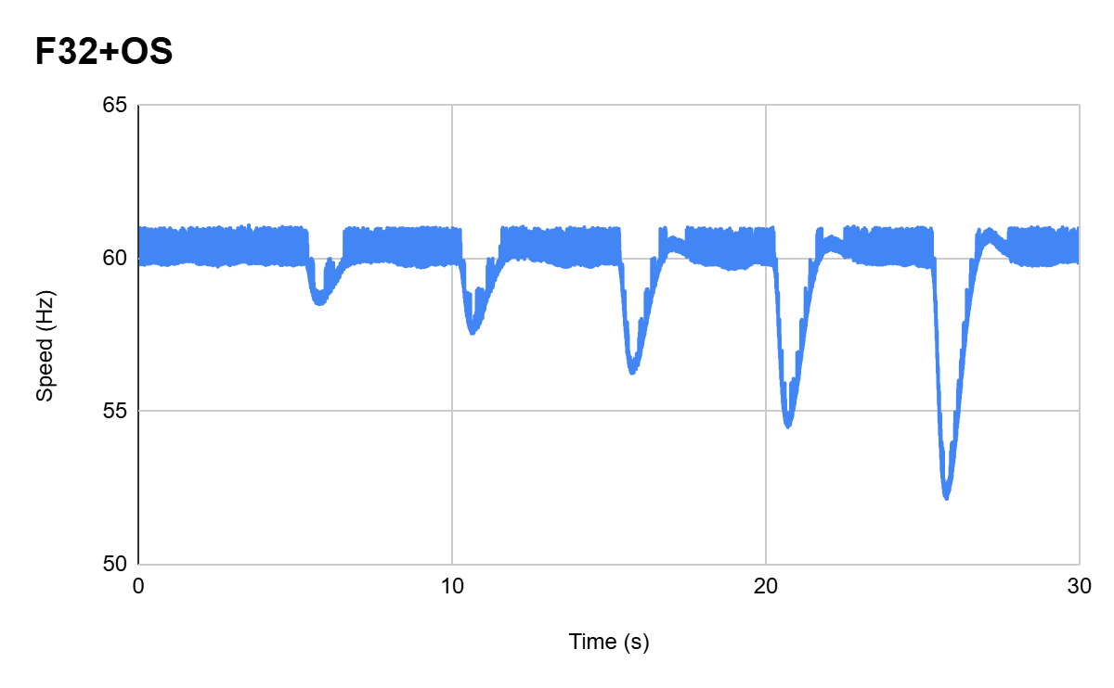
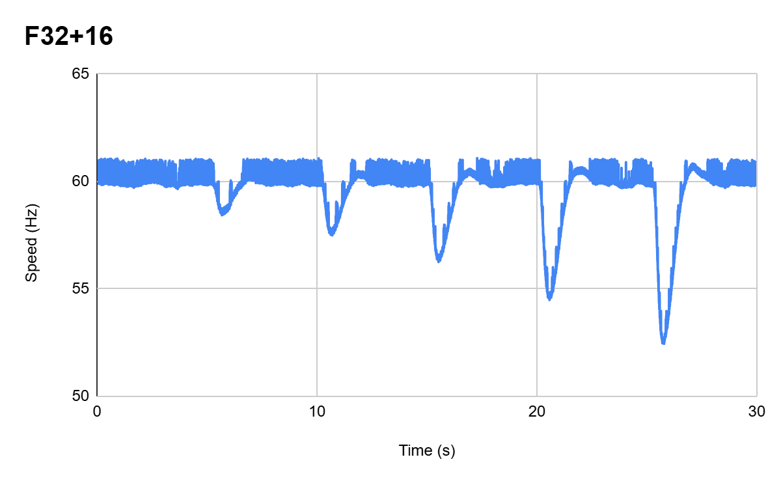
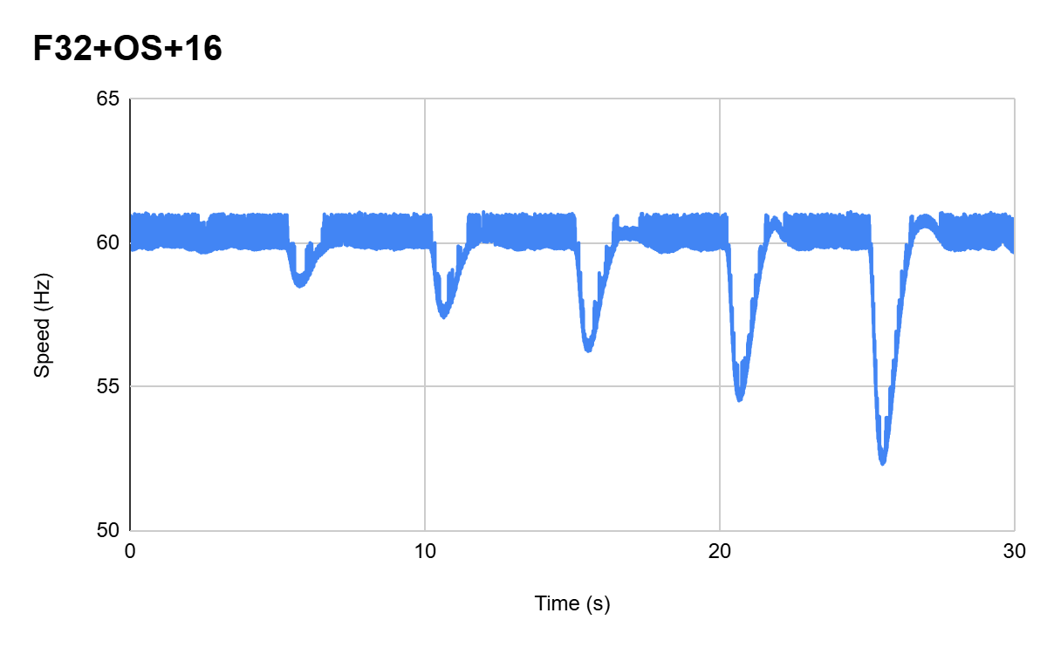

Slide 28
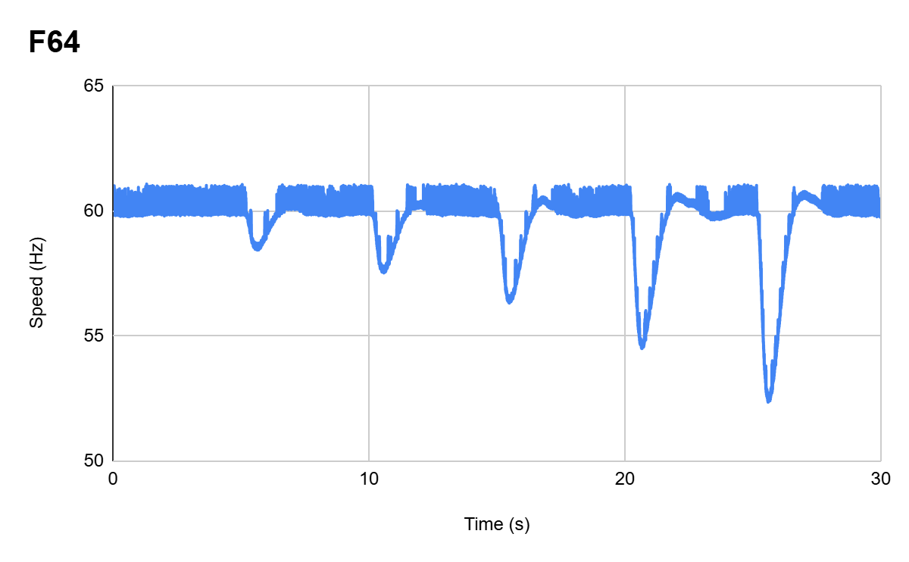

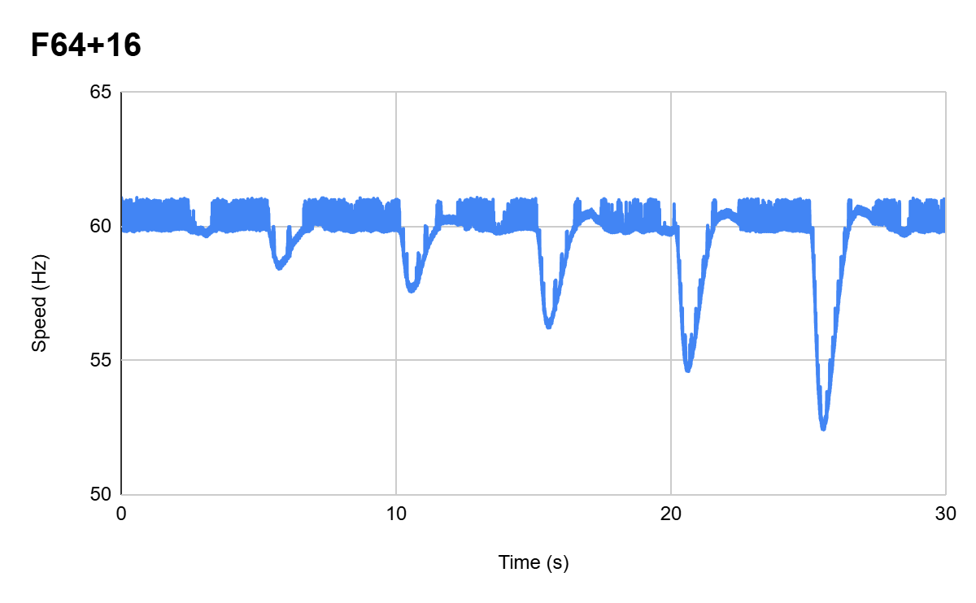
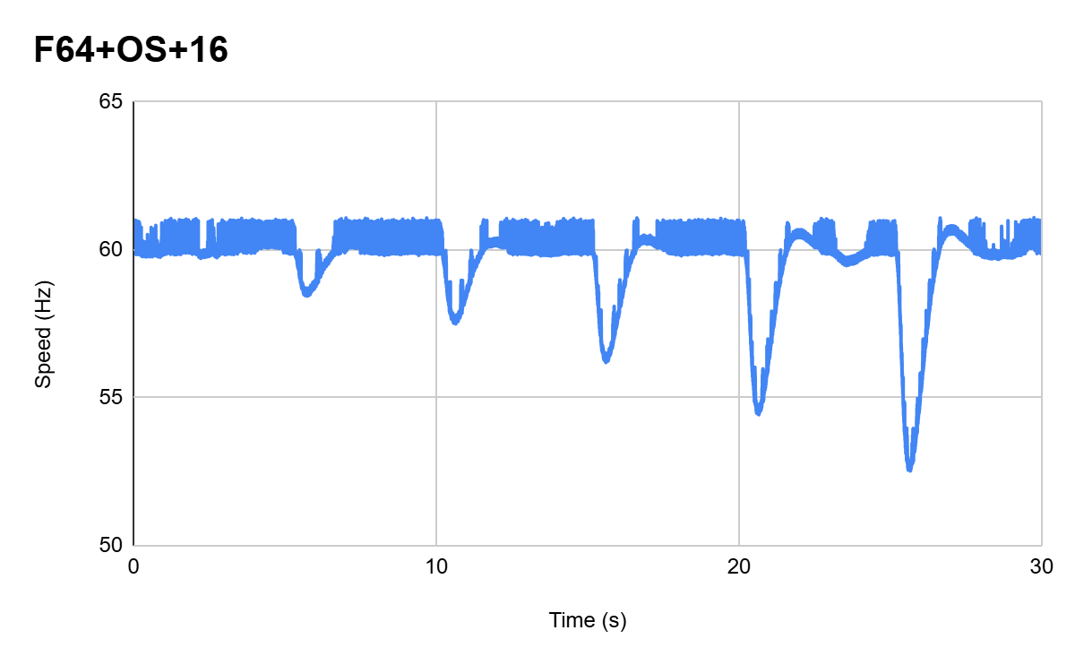

Slide 29
Further Analysis
Extract the time to settle after speed or load changes.
Measure how much overcorrection occurs after speed or load changes.
Test speed step with different acceleration values

Slide 30
Conclusions
Due to time constraints the support for an additional driver board and sysconfig were pushed to stretch goals
Our first rounds of testing has been completed
Very little to no noticeable performance gain in all tested metrics
In order to completely verify results we would like to repeat our testing to remove any errors or Inconsistencies

Slide 31
Thanks & Gig’em
ADC Resolution vs. Sensorless Motor Control Performance

